Slide 1
Math for Gameplay / AI John O’Brien Senior Gameplay Programmer Insomniac Games, Inc jobrien@insomniacgames.com jobrien@nc.rr.com

Slide 2
Overview
Basic Object Intersection Tests
Real gameplay example(s)
AI-specific topics
Bayes’ Theorem
Fuzzy Logic

Slide 3
Object Intersections
In simulation and AI code, we rarely want to use actual object meshes to test for collision.
Simplified collision representations are used instead.
Notes:
Make sure to mention that even though physics engines are becoming more commonly used, there is still a place for game-level simple representations.

Slide 4
Object Intersections
Gameplay and AI code often requires checks between “real” game objects and abstract things like zones.
AI usually needs to analyze and represent the world situation in a simplified way.

Slide 5
Bounding Spheres
Simplest representation.
Often used as 1st pass or screening check before using more detailed technique.

Slide 6
Bounding Sphere Representation
Only need a Point and a radius.

Slide 7
Bounding Sphere Pros and Cons
Sphere intersection tests very simple and cheap
Spheres are rarely a close fit to the shape of an object in the game world.

Slide 8
Sphere – Sphere Intersection
The spheres intersect if
A fast computation of this check takes the form:

Slide 9
Sphere – Plane Intersection
Using the center of the sphere as the origin, the sphere can be described as:
The equation for the plane is:

Slide 10
Sphere – Plane Intersection
Sphere and a plane intersect if d < r, where d equals the absolute value of the plane equation.

Slide 11
Axis-Aligned Bounding Boxes
An AABB is a box surrounding an object which is aligned to the world-axes.

Slide 12
AABB Representation
Can be represented by 2 points – the minimum and maximum x,y,z positions

Slide 13
AABB Pros and Cons
Pros
Simple representation
Very cheap intersection computations
Cons
Need to be re-computed each frame
Not necessarily a good fit to a model

Slide 14
AABB – AABB Intersection
Very simple to calculate. For each axis, and each object, check if the maximum for one object is less than the minimum for the other. If this is true for any axis, the objects do not intersect.
Repeat for each axis.

Slide 15
AABB – AABB Intersection
For each axis, the points describing these AABBs overlap.

Slide 16
AABB – Ray Intersection
Find the points where the ray crosses the x min, x max, y min and y max planes.
If the resulting line intervals overlap, there is an intersection.

Slide 17
AABB – Ray Intersection
To find the points , representing the intersections with the x min and x max planes, given a ray described by a point P and a vector v:

Slide 18
AABB – Ray Intersection
Test for overlap among (x1,x2), (y1,y2) and (z1, z2) segments.
There are many algorithms and approaches to this problem.

Slide 19
Swept Spheres / Capsules
A collision type that is oriented to a model rather than the world coordinate system.
Still relatively fast, and likely to be a better fit for many common objects in games.

Slide 20
Swept Sphere Representation
A swept sphere can be described by a line segment and a radius.

Slide 21
Swept Sphere Intersection
Two swept spheres intersect if the shortest distance between their respective line segments is less than the sum of their radii.

Slide 22
Shortest Distance Between Two Lines

Slide 23
Swept Sphere Intersection
Clamp resulting , to the end points of the two line segments.
This gives you . If its length is less than , then the swept spheres intersect.

Slide 24
Swept Sphere – Ray Intersection
Essentially the same as two swept spheres.
Line to ray distance is calculated, then compared to the radius.

Slide 25
Object Intersection Wrapup
Understanding basic collision/intersection techniques is still valuable.
Gameplay and AI code will always have abstracted views of the game world.

Slide 26
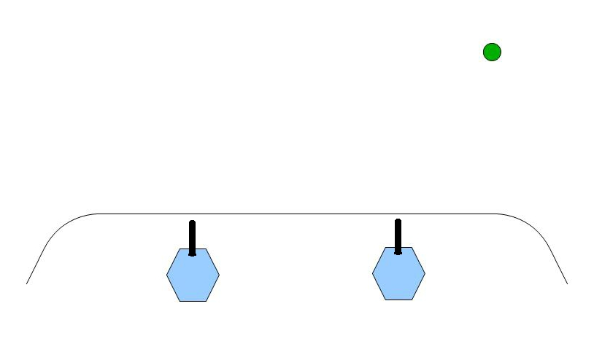
Example : Turrets on a Hill

Slide 27
Example : Turrets on a Hill
Determine which turret should fire at the target
Calculate turret facing
Calculate angle of the gun barrel
Convert to local object space for our engine.

Slide 28
Which turret should fire?

Slide 29
Which turret should fire?
One easy way is to take the dot product of our to_targ vector and the bunker’s left vector.
if (dot(to_targ, left) > 0.0)
turret = left_turret
else
turret = right_turret

Slide 30
Turret Facing
Turret can only rotate horizontally
We need the component of the vector from the gun barrel to the target that maps to the plane formed by the turret’s fwd and left vectors.

Slide 31
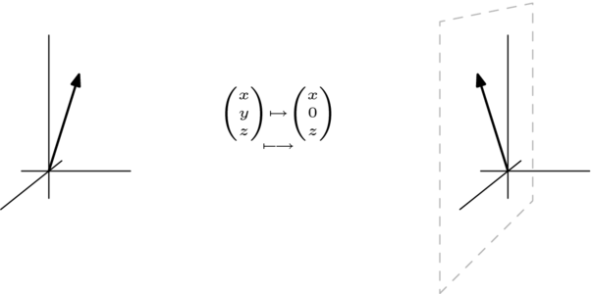
Orthographic Projection
Mapping of a 3D point to a 2D plane
Source: http://en.wikibooks.org/wiki/Linear_Algebra/Topic:_Geometry_of_Linear_Maps

Slide 32
Orthographic Projection
To project 3D point onto a 2D point , using a point parallel to the y axis:
where s is scale, and c is an offset

Slide 33
Projection to a Plane
To take the vector from the turret barrel to the target (v), and project it onto the turret’s horizontal plane, where (n) is the unit normal to that plane (up vector in this case):

Slide 34
Turret Facing
Now we have a vector along the plane the turret swivels in to use as desired facing.

Slide 35
Gun Barrel Aiming
Assuming that the gun barrel can only rotate up and down relative to the turret’s position…

Slide 36
Gun Barrel Aiming
We can isolate that desired vector by again projecting to a plane.
The desired Left vector is the normal to this plane.

Slide 37
Projection to a Plane Redux
We perform the same calculation using the desired left vector for the turret as n.

Slide 38
One More Step
We now have desired turret facing and gun barrel pitch vectors, in world space.
What if our engine requires them in local (object) space?

Slide 39
World -> Local Transform
Very common in games to move back and forth between local and world coordinates.
Local coordinates are the coordinate system where the center (usually) of an object is at (0,0,0), and the axes are usually aligned to the orientation of the object.

Slide 40
World and Local Coordinates

Slide 41
World ->Local Transform
To transform to local coordinates, we need a 4x4 matrix specifying the object’s axes and position.
Multiplying a vector by this matrix will yield a vector transformed into local space.
Use the inverse of the object’s matrix to convert back to world space.

Slide 42
Why Local Space?
Often easier to work with components of an object this way (ie. Joint hierarchies)
AI and gameplay calculations will frequently be based on something’s position relative to an object or actor.
Notes:
Tell Clank vac-u story here.

Slide 43
Local Space AI Example
Usage Area
Usage Area

Slide 44
Interpolation
Lerp and slerp have many more uses besides just generating curves.
e.g. We can simulate the motor of our turret revving up by lerp-ing from the current position to the desired using an appropriate function.

Slide 45
Splines
In Ratchet & Clank : All 4 One, there is an enemy with tentacle-style arms that can grab players. Splines are used to control the joint positions.
Fixed attachment
to shoulder
Fixed attachment
to player

Slide 46
Example Wrapup
Basic linear algebra is incredibly useful in games.
In games, we frequently need to express our algorithms in terms of a planar projection or an object’s local coordinate system.

Slide 47
Bayes’ Theorem
Named for Thomas Bayes, who used it to express subjective degrees of belief given pieces of evidence.
Was first published in 1763, 2 years after his death.
Did not gain widespread usage until the 20th century.

Slide 48
Bayes’ Theorem
A useful method for computing conditional probabilities
For game AI, it can be used to weight decision-making in situations with limited information.

Slide 49
Bayes’ Theorem
The probability of event A1, given that event B has subsequently occurred, is:

Slide 50
Bayes’ Theorem
If we know something about the conditional relationship between A and B, we can speculate on the likelihood of A occurring if B already has.

Slide 51
Bayes’ Theorem - Example
Event A1 - an attendee falls asleep in a Math tutorial during a discussion of Bayes’ Theorem
Event A2 - an attendee remains awake
Event B - a conference attendee is badly jet-lagged when attending the Math tutorial

Slide 52
Bayes’ Theorem - Example
Known probabilities:
P(A1) : 2% of attendees fall asleep
P(A2) : 98% of attendees remain awake
P (B | A1) : 90% of sleeping attendees are jet-lagged
P (B | A2) : 5% of awake attendees are jet-lagged

Slide 53
Bayes’ Theorem - Example
If we know an attendee is jet-lagged (event B), what is the probability of them falling asleep (event A1) while I am speaking?

Slide 54
Bayes’ Theorem - Example
P(A1) * P(B | A1) : 0.02 * 0.9 = 0.018
P(A2) * P(B | A2) : 0.98 * 0.05 = 0.049

Slide 55
Bayes’ Theorem Usages
Useful in any situation with incomplete information:
In an RTS, to estimate enemy army compositions.
In a shooter, to predict enemy tactics
Help eliminate “saddle points” in your AI

Slide 56
Fuzzy Logic
A method that involves approximate reasoning, rather than strict true or false propositions.
A given proposition has a degree of truth ranging from 0.0 to 1.0
Deals in possibilities, not probabilities

Slide 57
Fuzzy Logic History
First formulated in 1965 in a proposal on Fuzzy Set Theory by Lofti Zadeh.
Has been successfully used in AI systems, particularly robotics and other hardware control systems.
Good for games for the same reason it is good for robotics : it handles chaotic environments and incomplete information.

Slide 58
Fuzzy Sets
Traditional sets have absolute membership: my ammo clip is either empty or full.
A fuzzy set allows for degrees of membership. If I have 70% of my ammo, then we might say my clip has a 0.7 degree of membership in the Full set.

Slide 59
Fuzzy Sets
Another key point is that fuzzy logic sets are not mutually exclusive: my ammo clip belongs to both the Full and Empty sets to some degree.

Slide 60
Fuzzy Logic in Game AI
Can help us escape from hard “if-then-else” rules, which can break down given unexpected or rare input.
Helps make an AI more likely to do something “reasonable” even in a very unlikely or unanticipated situation.

Slide 61
Fuzzy Logic in Game AI
Consider the following rules:
Low on ammo : take cover and reload
Under heavy fire : take cover
Badly outnumbered: take cover
In a traditional implementation, these are each absolutes, that need to be satisfied completely in order to be processed.

Slide 62
Fuzzy Logic in Game AI
A Fuzzy approach would be :
Low ammo factor + taking fire factor + outnumbered factor = weight of taking cover
We can weight our entire action set this way, and choose a good course of action.

Slide 63
References
Van Verth, Jim & Bishop, Lars. Essential Mathematics for Games And Interactive Applications. Morgan Kaufman, 2004
Yudkowsky, Elizier. An Intuitive Explanation of Bayes’ Theorem. http://yudkowsky.net/rational/bayes
Wolfram MathWorld. http://mathworld.wolfram.com
Kaehler, Steven. Fuzzy Logic – An Introduction. http://www.seattlerobotics.org/encoder/mar98/fuz/flindex.html

